Slide 1

Finding the Right Ingredients:
THE Labour market AND Toronto's food & beverage processing sector
A presentation by John MacLaughlin
The Anova Partnership
Notes:
The hardest part was thinking of a title.
Anova partnership. Senior Village Idiot.

Slide 2
The secret lives of statisticians:
Survey says…Food and beverage production is Critically important for the GTA and ONTARIO
A presentation by John MacLaughlin
The Anova Partnership
Notes:
How did Elevate Start. Feasibility study to replicate I-BEST from Washington state (program designed for unemployed lower skilled individuals. No one liked Food Manufacturing. Wanted IT, or Financial.

Slide 3
WTF are you doing – I’m Just a dumper:
Tales from the Production Line
A presentation by John MacLaughlin
The Anova Partnership

Slide 4
How food factory Changed My Life:
A decade of working around food
A presentation by John MacLaughlin
The Anova Partnership

Slide 5
Overview
Elevate Canada.
Finding the Right Ingredients.
Manufacturing Study of Toronto, Peel, Halton and York Region.
Contract Food Study.
Working Paper on ASO’s
Daily Lectures from the “expert”. A living example of a Career Pathway in Food.

Slide 6
FOOD and Beverage - Largest subsector

Slide 7
Food and Beverage Manufacturing Sector
Third Largest Cluster In North America
Moderate Growth In Toronto Over Past Decade – mostly in Baking and Beverage
Currently Employs Over 70,000 People In The Greater Toronto Region With Sales Of About $18 Billion
The jobs are not so different than those in industrial kitchens
Move to smaller and hybrid firms reflecting artisan production

Slide 8
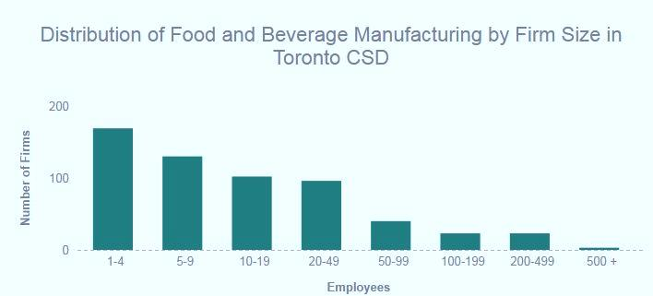
Lots of smaller firms

Slide 9
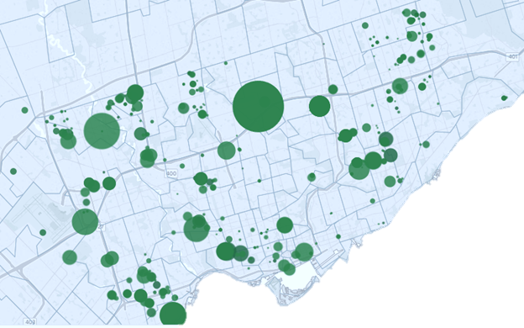
Food and Beverages Production Its everywhere

Slide 11
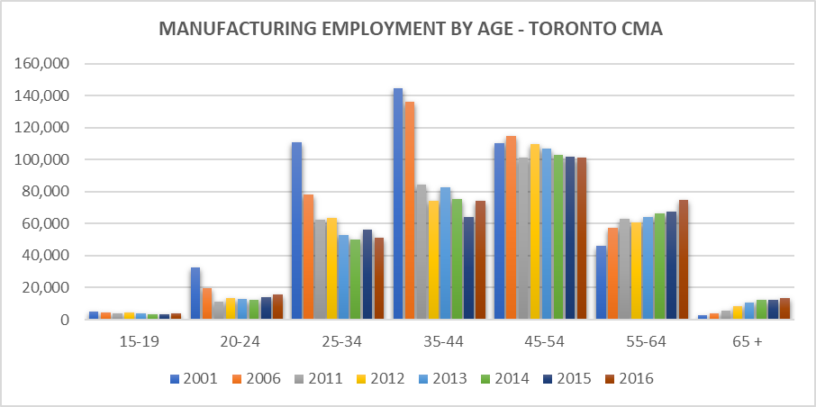
The GREY TIDE IS UPON US

Slide 12
IN SHORT
AGING WORKFORCE minus Fewer entrants into labour force + F&B industry growth = BIG TROUBLE

Slide 13

What do Employer’s Want?
The skills and attributes sought by employers vary and appear to be aligned with desired workplace culture. All employers cited the importance of ‘soft skills’ such as positive attitude, reliability and punctuality.
Most of the firms do not require any specific education or training for entry-level production positions.
Many of the larger firms draw heavily on recent and established immigrants to fill production positions.
Some companies face an aging production workforce (across all occupations) and several remarked on their inability to attract younger workers.

Slide 14

Working Conditions
Variety in working conditions. Employees in many production facilities have to do repetitive tasks, standing for extended periods, and high levels of noise.
Wages across employers vary. Some companies pay new production workers minimum wage and offer minimal or intermittent wage increases. Others offer starting wages of $14 to $16 and provide wage increases on a regular basis. Salaries appear to top out around $18 to $19 for most production positions.
Other occupations are paid at competitive rates (sanitation, office, and sales).
Most employers indicated that they provide benefits. Several also offer bonuses and non-monetary incentives.
Many firms offer solid opportunities for advancement
Small operations call for individuals who can multi-task and do different types of jobs.

Slide 15
KEY INSIGHTS
Significant labour demand and increasing wages in both Ontario and Toronto CMA.
Reliance on temporary workers – nature of the beast.
Bakeries, meat production, beverages and “other” industry groups dominate Toronto.
The huge increase in number of “Hybrid Food Firms” and they face big challenges.
Decrease in large manufacturers, increase in small manufacturers. Industrial Kitchens increasing at rapid pace.

Slide 16
KEY INSIGHTS
Despite conventional wisdom, food production is evenly spread across all regions of Toronto.
The food and beverage manufacturing labour force is aging at a rapid pace.
Publically funded workforce development system is not designed to deal with small firms and has a bad attitude to jobs in the industry……..but signs this is changing.
Elevate at PTP, HWTC, Sector and possible ASO pilot in “Food” (Chicagoland).

Slide 17
Questions? Thank YOU

