Slide 1

Finding the Right Ingredients for the Food & Beverage Processing Sector
OCTOBER 29, 2018

Slide 2

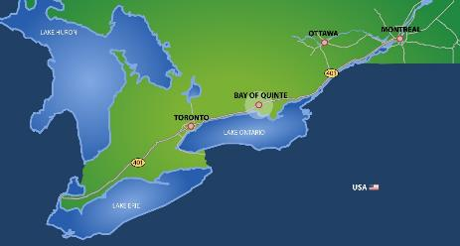
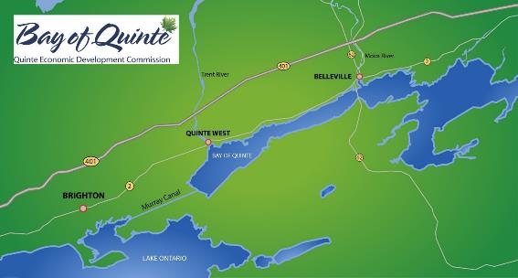
Project location
Notes:
To help locate where the project is taking place

Slide 3
Elevate Plus is a collaborative workforce development strategy for the Greater Bay of Quinte Region manufacturing sector.
It provides:
Jobs for people, People for jobs
through strong, collaborative, community based partnerships
using an integrated, experiential, accelerated learning platform

Slide 4
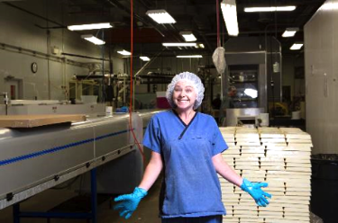
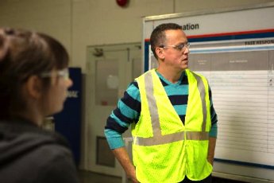
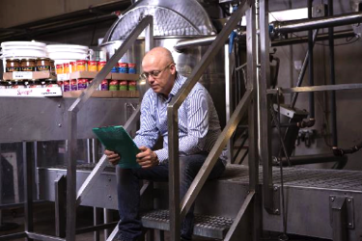
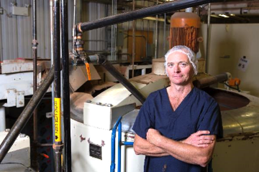
Why a workforce development program for manufacturers?

Slide 5













































~110 manufacturers ~10,000 employees
Notes:
A strong collection of over 110 manufacturers with approximately 10,000 employees

Slide 6
Labour Force Characteristics
SEPTEMBER 2018 STATISTICS CANADA EMPLOYMENT STATS
 | Canada | Ontario | ER3530 Toronto | ER3515 Kingston-Pembroke
Population | 30,351,300 | 11,929,600 | 5,698,100 | 384,500
Labour Force | 20,049,000 | 7,782,400 | 3,787,000 | 219,100
Not in Labour Force | 10,302,300 | 4,147,300 | 1,911,100 | 165,400
Unemployment Rate | 6.0 | 6.0 | 6.6 | 5.5
Employment Rate | 62.1 | 61.3 | 62.7 | 53.8
Participation Rate | 66.1 | 65.2 | 66.5 | 57.0
We have a lower unemployment rate than Canada, Ontario and Toronto
BUT
We have a lower employment rate and participation rate

Slide 7
What our Manufacturers Told Us
What challenges are you currently facing or anticipate over the next few years and what impact are they having on your business?
 | No expected impact | Small impact | Large impact
Number and/or quality of applicants | 3% | 37% | 60%
Absenteeism | 11% | 29% | 60%
Aging affecting workforce (i.e. accommodations, health) | 14% | 29% | 57%
Retirements | 14% | 29% | 57%
Upcoming changes to the Employment Standards Act | 6% | 40% | 54%
Wages/Benefits | 14% | 34% | 51%
Employee turnover | 17% | 34% | 49%
Worker physical wellness issues | 14% | 43% | 43%
Worker mental health issues | 9% | 54% | 37%
Legalization of marijuana, identifying impairment, when can be used? | 29% | 34% | 37%
Generational differences | 17% | 51% | 31%
Presenteeism (at work but not engaged and productive) | 11% | 57% | 31%
Accommodation requirements | 11% | 63% | 26%
Job abandonment | 37% | 43% | 20%
Personal goals of people (i.e. work life balance) | 11% | 71% | 17%
Labour Unions | 74% | 11% | 14%
* 2017 QEDC Sector Partnership Planning Grant, 32 respondents representing 28 companies
Notes:
7

Slide 8
What our Manufacturers Told Us
What are the reasons that you are having difficulties filling entry level positions
 | This is an issue
Applicants not meeting motivation, attitude or interpersonal skills requirements | 71%
Not enough applicants | 58%
Nature of work schedule (seasonal, shift work, irregular hours) | 48%
Public transit issues | 42%
Nature of work (i.e. temperature, manual , automated, job content) | 35%
Applicants not meeting company requirements (i.e. Clean criminal record, Grade 12) | 32%
Turnover/job abandonment | 26%
Inability to compete with other employers due to pay and benefits | 23%
Applicants not meeting qualifications (education levels/credentials) | 23%
Applicants not meeting technical skills requirements | 23%
Applicants not meeting work experience requirements | 19%
Remote location | 16%
Inability to compete with other employers due to promotion opportunities | 12%
Reputation as an employer | 6%
No applicants at all | 3%
* 2017 QEDC Sector Partnership Planning Grant, 32 respondents representing 28 companies
Notes:
8

Slide 9
What our Manufacturers Told Us
 | New hire skill sets: How important they are and are they lacking in new hires
 |  | Important or very important | Generally lacking in new hires
1 | Teamwork | 97% | 24%
2 | Self-motivated / ability to work with little or no supervision | 94% | 69%
3 | Work ethic / dedication / dependability / conscientiousness | 94% | 79%
4 | Cognitive skills (ability to learn new skills) | 91% | 24%
5 | Interpersonal skills | 88% | 41%
6 | Self-management (ability to manage own emotions) | 85% | 52%
7 | Oral communication skills | 76% | 24%
8 | Literacy skills issues | 74% | 17%
9 | Numeracy skills issues | 74% | 31%
10 | Professionalism | 68% | 45%
11 | Computer literacy (first technical skill at #11) | 59% | 14%
12 | Technical skills | 56% | 55%
13 | Automation skills (coping with automation) | 53% | 34%
14 | Customer service | 50% | 10%
15 | Written communication skills | 50% | 31%
16 | Leadership / Supervision / Management skills issues | 32% | 17%
17 | Knowledge of continuous improvement items (i.e. 5S, Lean) | 26% | 41%
18 | Analytical / research skills | 21% | 24%
19 | Industry specific knowledge | 21% | 45%
20 | Leadership Skills | 21% | 34%
* 2017 QEDC Sector Partnership Planning Grant, 32 respondents representing 28 companies
Notes:
9

Slide 10
Supporting Our Manufacturers
Elevate Plus is designed to:
Respond to industry’s stated staffing needs
  Provide an ongoing pipeline of skilled employees to fill local front line vacancies
  Address challenges with the labour market
Add value to local manufacturing sector by reducing costs and increasing productivity
  Augment manufacturer retention strategies with expanded on-boarding, coaching, mentoring and post-hiring support
  Support manufacturers in improving workplace culture of engagement and continuous improvement
Engage and facilitate additional manufacturing involvement

Slide 11
QEDC/LTKC Partnership
Quinte Economic Development Commission (QEDC) and Loyalist Training and Knowledge Centre (LTKC) have a long history of collaboration including:
  Skills Development funding support and training delivery of the incumbent workforce
  Pre-Employment Training
  Business Performance Solutions - to support manufacturing training and lean assessments. LTKC is a delivery partner
  Partnership on manufacturing Labour Market Studies, facilitated symposium, on-going advice and guidance
  Site selection assistance, company specific training, funding application concept and support
  Others
“Workforce Development is Economic Development”
Notes:
It is a collaborative project between QEDC and LTKC

Slide 12
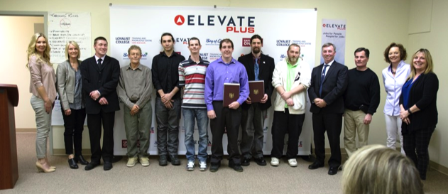
Supporting Our People
Elevate Plus is designed to assist participants by:
Increasing self-confidence and self-esteem
Providing training for integrated technical and soft skills development
Renewing their sense of hope
Increasing their stability and resilience
Providing them with employment
“Advancing Change, Creating Hope
and Building Resilience”

Slide 13
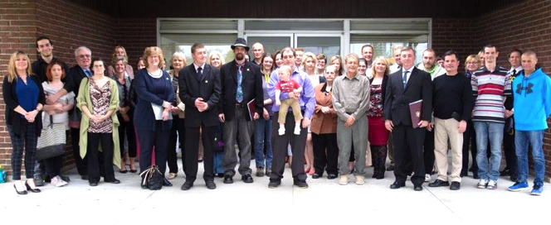
Supporting Our Communities
Elevate Plus assists the community by:
Reducing the burden on social programs (ave. $600/month OW savings)
Mobilizing and leveraging resources, sharing costs reduces costs
Strengthening inter-agency connections / collaborations
Building community capacity to address community issues
Providing them with employment

Slide 14
Program Funding
Elevate Canada: Raising the Grade for Food Processing (2013-2015)
6 partner organizations
6 Communities
17 employers
9 cohorts
Elevate (2015-2016)
EO CFDC / HCCHS 1 cohort
Trenval CFDC / HCCHS 2 cohorts
Elevate Plus (2016-2019)
Provincially funded (MAESD) SkillsAdvance Ontario pilot project
Contract with QEDC, LTKC is contracted to deliver training and mentoring
One of three initial SAO pilot projects in Ontario
7 additional SAO projects subsequently announced

Slide 15
About The Program
Class is held in the local community not at Loyalist College
Program duration: 6 weeks, 5 days/week.
  In class portion 19 days (9AM – 3PM)
  1 day of plant tours conducted early in the schedule.
  Workplace portion 10 days (workplace shift hours)
Course schedule
  3 weeks in class
  2 weeks job trial at an employer partner
  1 week in class
  HIRED!

Slide 16
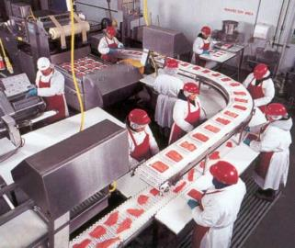
Key Elements
Employer specific training integrated with literacy, language and essential skills
Workplace training co-designed with industry
Engaging, experiential, adult learning platform
Co-ordination of wrap-around supports
Workplace job trial with local employers
Certificate from Loyalist College
Job coaching
Tuition free
With a Plus
Multiple manufacturers representing various manufacturing subsectors
Development of employer capabilities to onboard and support employees

Slide 17
Curriculum
FUN! Engaging with lots of variety
Hands on, experiential, adult learning
Integrates “soft” skills with “hard” (technical) skills and essential skills
Learn self-awareness, personal keys to success, working with others
Participants keep their work binder for reference
Co-designed with industry

Slide 18
Curriculum
Lean Manufacturing Essentials
5S/Visual workplace
Hazard recognition
HACCP
GMPs
H&S
…and more technical skills
Communication skills
Personality Dimensions
Conflict resolution
Accountability
Personal Effectiveness
Employer Expectations
…and more soft skills

Slide 19
Program Content
 |  | Monday | Tuesday | Wednesday | Thursday | Friday
Week 1 | AM | Welcome to the program | Personality Dimensions | Working in a Manufacturing Team | Good Manufacturing Practices (GMPs) | Tour of partner Manufacturing Facility 1
 | PM | The Business of Food & Beverage Manufacturing in the Quinte Region | Expectations of Employers and Your Coworkers | Lean Manufacturing Essentials | Exploring Your Key Success Factors | Tour of a partner Manufacturing Facility 2
Week 2 | AM | Tour Review: Communication | Tour Review: Preventing Foodborne Illness & Good Manufacturing Practices (GMPs) | Communication with Others and Your Boss | Safety First: Your Obligations Under the OHSA | Preventing Foodborne Illness & Preventing Contamination
 | PM | Tour Review: Safety, Ergonomics and Back Care | More About Your Success: Key take away from the week | Emotional Intelligence: What to Do When You Don't Understand & Dealing with Your Anger | Personal Safety & Basic first Aid Overview | 5S / Visual Workplace & Quick Changeovers (SMED)
Week 3 | AM | Protecting Your Hearing and Other Important PPE | A Day in the Life of a Food Plant: Food Safety Standards & Seafood Plant Module | Getting Ready for Placement | Hand Washing | HACCP & Safe Foods for Canadian Regulations (SFCR)
 | PM | Physical Demands of the Job On The Body (YMCA) | Documents and Instructions in the Workplace | Getting Ready for Placement | WHMIS | Key takeaways from first three weeks
Week 4 |  | JOB TRIAL | JOB TRIAL | JOB TRIAL | JOB TRIAL | JOB TRIAL
Week 5 |  | JOB TRIAL | JOB TRIAL | JOB TRIAL | JOB TRIAL | JOB TRIAL
Week 6 | AM | Individual Performance Review with Your Coach | The Job Search: Planning | The Job Search: Letter Writing | The Job Search: Interviewing | Program Wrap Up & Workplace Transitioning
 | PM | Individual Performance Review with Your Coach & Lessons learned | The Job Search: Resume Design | The Job Search: Contacting Employers | Graduation Ceremony & The Job Search: Interviewing | Program Wrap Up & Workplace Transitioning

Slide 20














Manufacturer Partners
Vantage Foods Inc.
CB Freezers
Trenton Cold Storage
Drossbach
Berry Global
Anamet Canada
Hain Celestial
Hanon Systems Canada
GH Manufacturing
Cascades
Kruger Products
Premier Tech
Horizon Plastics
Lorenz Conveying
CPS Wood Products

Slide 21
What do we ask of our Manufacturer Partners?
Participating manufacturers:
Demonstrate that they have vacancies that have the potential to be permanent with long-term sustainability and opportunities for advancement
Demonstrate the ability to provide the placement participant with adequate supervision and experience as described in the placement agreement
Collaborate with fellow partners on an active and ongoing basis in identifying specific skills requirements associated with vacancies, and in developing sector-focused employment services and training curriculum

Slide 22
Benefits To Employers
Augments and supports recruiting efforts
Provides skilled employees that are ready to work
Employees are ready to hit the ground running
Strong team players that contribute to culture change and continuous improvement
Employees with both technical and soft skills
Improved retention rates
Positively impacts the bottom line!
*Estimates of the cost of employee turnover for entry level positions average around 30% to 50% of an employee’s annual salary. This includes costs related to hiring, onboarding and training, learning and development and time when a role is unfilled.
For a $15/hour job turnover can amount to
$10,000/person at a 33% turnover cost.
* https://www.linkedin.com/pulse/20140701121556-17497251-the-cost-of-employee-turnover/

Slide 23
Manufacturer feedback
“Elevate Plus is a critical piece of our Human Resources strategy at Vantage Foods Inc.
It’s comprehensive training program provides participants with the requisite skills to meet the employment demands within our fast paced, HACCP approved food manufacturing facility.
The post-graduation support services ensure long term success and increased retention rates.
Team members, who have been hired through the Elevate Plus program, add immediate value to our organization as a result of the opportunity they are given.”
Rob Yorki,
Manager of Human Resources
Vantage Foods

Slide 24
Employer Training & Support
One “PLUS” in Elevate Plus is the improving the capabilities of manufacturers to effectively onboard, develop, support and retain their employees.
Training and support for manufacturers include:
Ongoing interaction (in person and via phone, email and text) with project staff to address issues related to participants and how supervision and management at the plants can assist with a resolution
Training on:
  Enhancing Onboarding Through Mentoring & Coaching
  Mental Health Awareness
  Train the Trainer

Slide 25

Coaching And Mentoring
Enhancing Employee Onboarding through Mentorship and Coaching
It will:
Build employer capability and the capacity of internal mentors and coaches to help improve on boarding results and overall job retention
It will help position employers to:
Increase organizational responsiveness to employees, market and clients
Drive fundamental change in a very practical way
Reduce turnover and improve job retention
Maintain adaptability to changing needs
Reduce staffing related costs
Requirements:
4 days of workshops over 4-6 week period
Out of class preparation
Insert Mentor Coach Picture

Slide 26
Mentoring & Coaching Training for Employers
A few quotes from class
“Day One was an
Eye Opener”
“Training was helpful and informative”
“Learned how to approach employees”

Slide 27
Participant Eligibility
Unemployed (average < 20hrs/week)
Not participating in full-time training or education
18 years of age or older
Require an intensive intervention that includes all mandatory project components to obtain and advance in employment
Have poor employment history, for example, long-term unemployment, underemployed, or precariously employed, including interruptions in work history
Have low household income or dependence on non-employment income sources, such as social assistance or employment insurance benefits
Are low-skilled, (for example, do not possess a postsecondary-level diploma/degree or trades certification, or require essential skills training or upgrading)
Are interested in pursuing a career in manufacturing, and demonstrate potential for success in the Project model and subsequent employment in identified vacancies

Slide 28
We Coordinate and/or Provide
Wrap Around Supports
Program staff partner with local agencies to provide on-going support
Removing barriers so the participant can focus on learning
  Transportation
  Day-Care
  Food Insecurity
  Mental Health
  Family Well-being
  Access to Health Care
  Criminal Record Check
  Drug and Alcohol counselling referrals

Slide 29
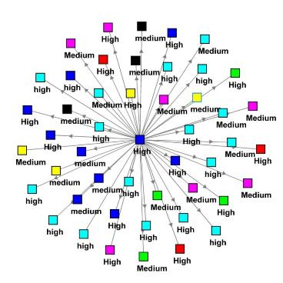
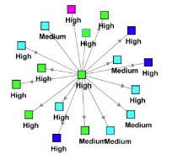

Community Partnerships
Strong collaborative community partnerships make this work
Quinte Cohort Social Network Map showing various levels of engagement
Lead organization
Social services
Employers
Economic/business development
Government
Non-profit
Police services
Social Network Map for another location
Source: An Examination of Social Capital in the Elevate Project Using Social Network Analysis

Slide 30
Results
6 Cohorts Elevate (74 participants)
10 Cohorts Elevate Plus (135 participants)
Elevate Plus 1 Year Employment Status
EP Cohorts 1 to 10
135 people
78%
EP Cohorts 1 to 5
54 people
The graduation rate for the 6 Elevate cohorts was 82%

Slide 31
Stats
Elevate Plus Team
Neil Dick – Coordinator & Facilitator
Chuck O’Malley - Project leader (LTKC Corporate Account Manager)
Dan Brennan - Job coach / councillor
Lori Smith - Job coach
Pam Wilson - Job coach
Brad Monkman – Administration
Mike Hewitt – Contract administrator

Slide 32
Lessons Learned
Program success depends on community and employer partnerships
The relationship between the employer, the delivery agent, and the community needs to be strong
Successful participants MUST WANT to work
Participant screening is very important
Self-awareness, personal growth, and support circle are keys to graduate success
Self-confidence and self-esteem are the biggest transformation
Personal mentoring, coaching, and support after training strengthens retention
Cohorts of around 12 are a good size
“Soft skills” are the hard skills!

Slide 33
Success factors
Common goals
Customer first approach to business (the participant AND the employer)
Proactive approach to bring forward new ideas, programs, modules
Responsive to industry needs and react to opportunities
Connectivity and collaboration with the community and businesses
Business sector that is hiring
Communication
Win-win approach
Working with people who can “get stuff done”
Celebrating our successes

Slide 34
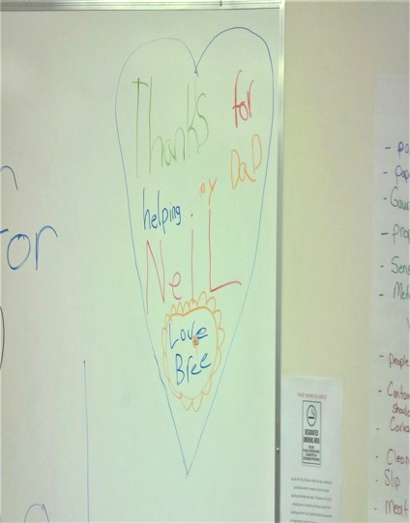
From an 8 year old

Slide 35
Questions & Comments
Neil Dick
Coordinator & Facilitator- Elevate Plus
Loyalist Training & Knowledge Centre
NDick@loyalistcollege.com
613-969-1913 ext. 2635
Mike Hewitt
Manufacturing Resource Centre Coordinator
Quinte Economic Development Commission
mike@quintedevelopment.com
613-961-7990 ext. 226

